Slide 1
CONTROL OVER CHAOS: A SYSTEMS CRITIQUE OF PROGRAM LOGIC
Presentation to AES International Conference, Sydney 2011
Graham Smith

Slide 2
Main concepts
Centrality of program logic
  BUT: May fail to explain results
Systems Theory
  Complexity theory
  Chaos theory
  Complex adaptive systems
  CAN be stable through feedback

Slide 3

Control versus Kaos
Source: wouldyoubelieve.com

Slide 4
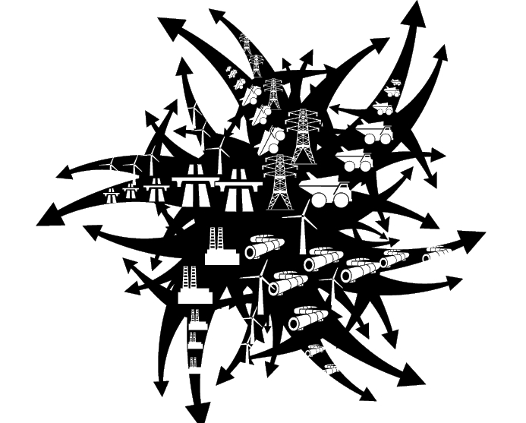
CHAOS
Utter confusion and disorder (OED)
dynamical systems that are highly sensitive to initial conditions (wikipedia)

Slide 5
Control
Impose order on an unruly universe
Restrain; exercise authority (OED)
Verify (audit)

Slide 6
Basic Program Logic
Impact
Outcome
Output
Activities
Input

Slide 7
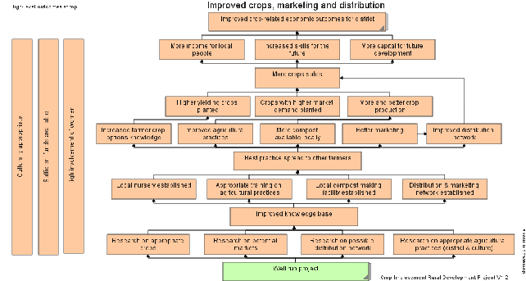
A complicated logic model
From Duignan, P. http://www.outcomesmodels.org/

Slide 8

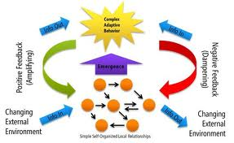
Complexity theory
Chaos Theory
Complex Adaptive Systems

Slide 9
Feedback
Reduces significance of ‘level’ in program logic
  E.g. results can influence inputs and activities
Model can influence reality

Slide 10
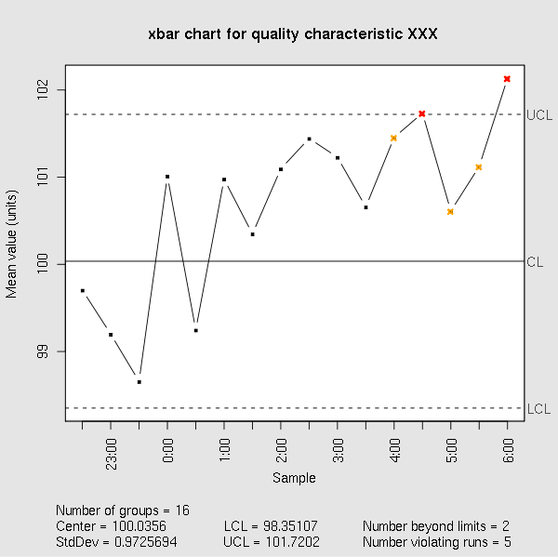
Control

Slide 11
Logic model description of a program

Slide 12
Systems description of a program

Slide 13
Logic Models revisited
Funnell & Rogers: Theory of change to include situational analysis to explore wider context.
Noga and Hargreaves: Theory of action to include boundaries, relationships and audiences.
These approaches do include systems elements
not always implemented
still considered as ‘context’

Slide 14
Home Insulation Scheme
Program theory: Subsidy leads to increased installation of insulation leads to energy savings and to economic activity.
Context:
  Unskilled work
  Low barriers to entry
  Small industry
  Speed of implementation

Slide 15
Home Insulation Scheme (2)
Result: opportunities for rorts and poor practice
Lack of control led to chaos

Slide 16

The End
Graham.smith@numericaladvantage.com.au

